Slide 1
Android Boot Camp for Developers Using Java, 3E
Chapter 5: Investigate! Android Lists, Arrays, and Web Browsers

Slide 2
Objectives
In this chapter, you learn to:
Create an Android project using a list
Develop a user interface that uses ListView
Extend the ListActivity class
Use an array to create a list
Code a setListAdapter to display an array
Design a custom ListView layout with XML code
Display an image with the ListView control
Change the default title bar text

Slide 3
Objectives (continued)
Code a custom setListAdapter for a custom layout
Call the onListItemClick method when a list item is selected
Write code using the Switch decision structure
Call an intent to work with an outside app
Open an Android Web browser
Launch a Web site through the use of a URI using an Android browser
Test an application with multiple decisions

Slide 4
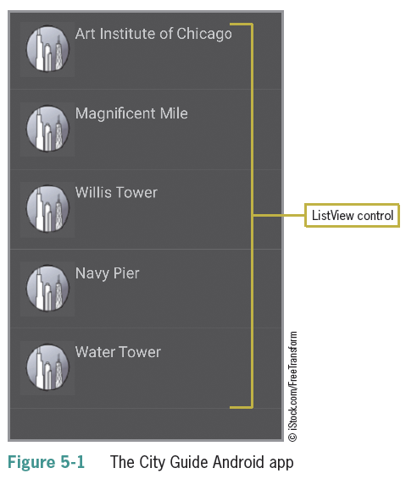
Creating a List
Lists are one of the most common designs in mobile apps
Scrollable
Selectable
Programmable to bring up the next Activity (screen)

Slide 5
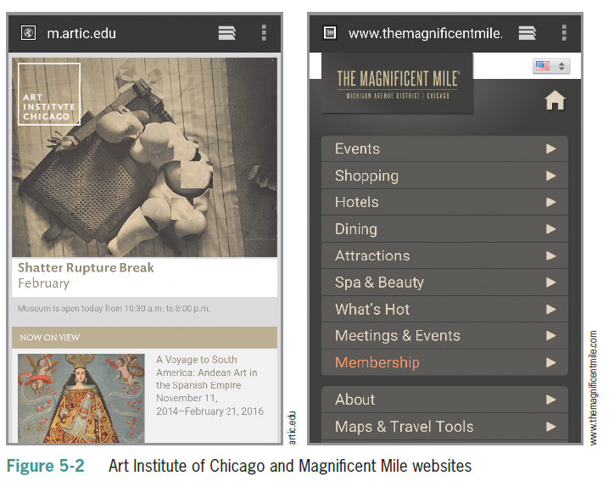
Creating a List (continued)

Slide 6

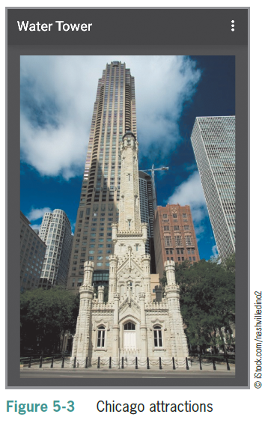
Creating a List (continued)

Slide 7
Creating a List (continued)
Steps to complete the app:
Create a list using a ListView control.
Define an array to establish the items of the list.
Add the images used in the project.
Define an XML file to design the custom list with a leading image.
Code a Switch decision structure to handle the selection of items.
Open an Android Web browser to display a specified Uniform Resource Identifier (URI).
Create multiple classes and XML layout files to display pictures of attractions.

Slide 8
Creating a List (continued)
Opening screen contains a vertical list of attractions
List is automatically scrollable if it exceeds the window size
ListView is better than TableLayout View because each row can be selected for further action
Selecting an item opens up a related Web page or an image of the attraction

Slide 9
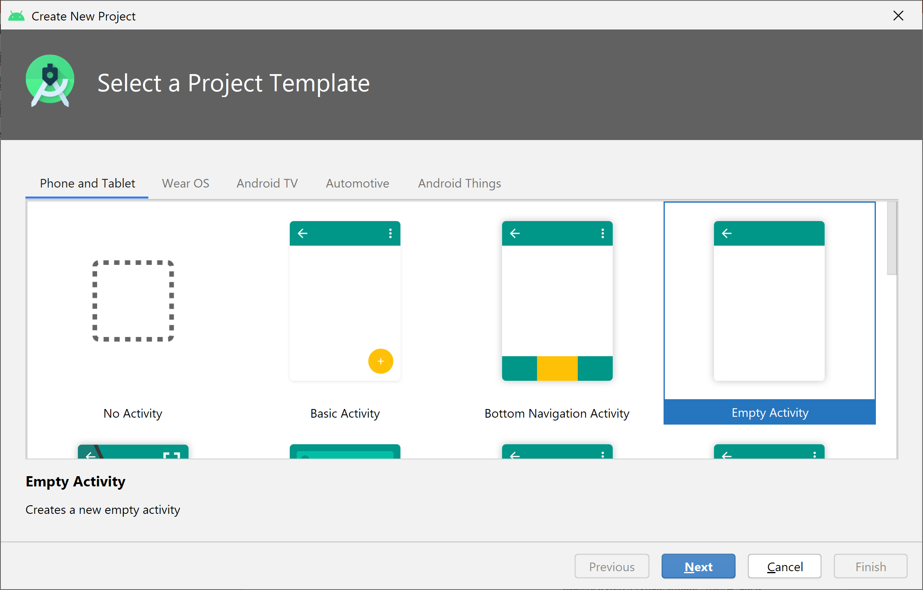
Extending a ListActivity
Create an Empty Activity

Slide 10
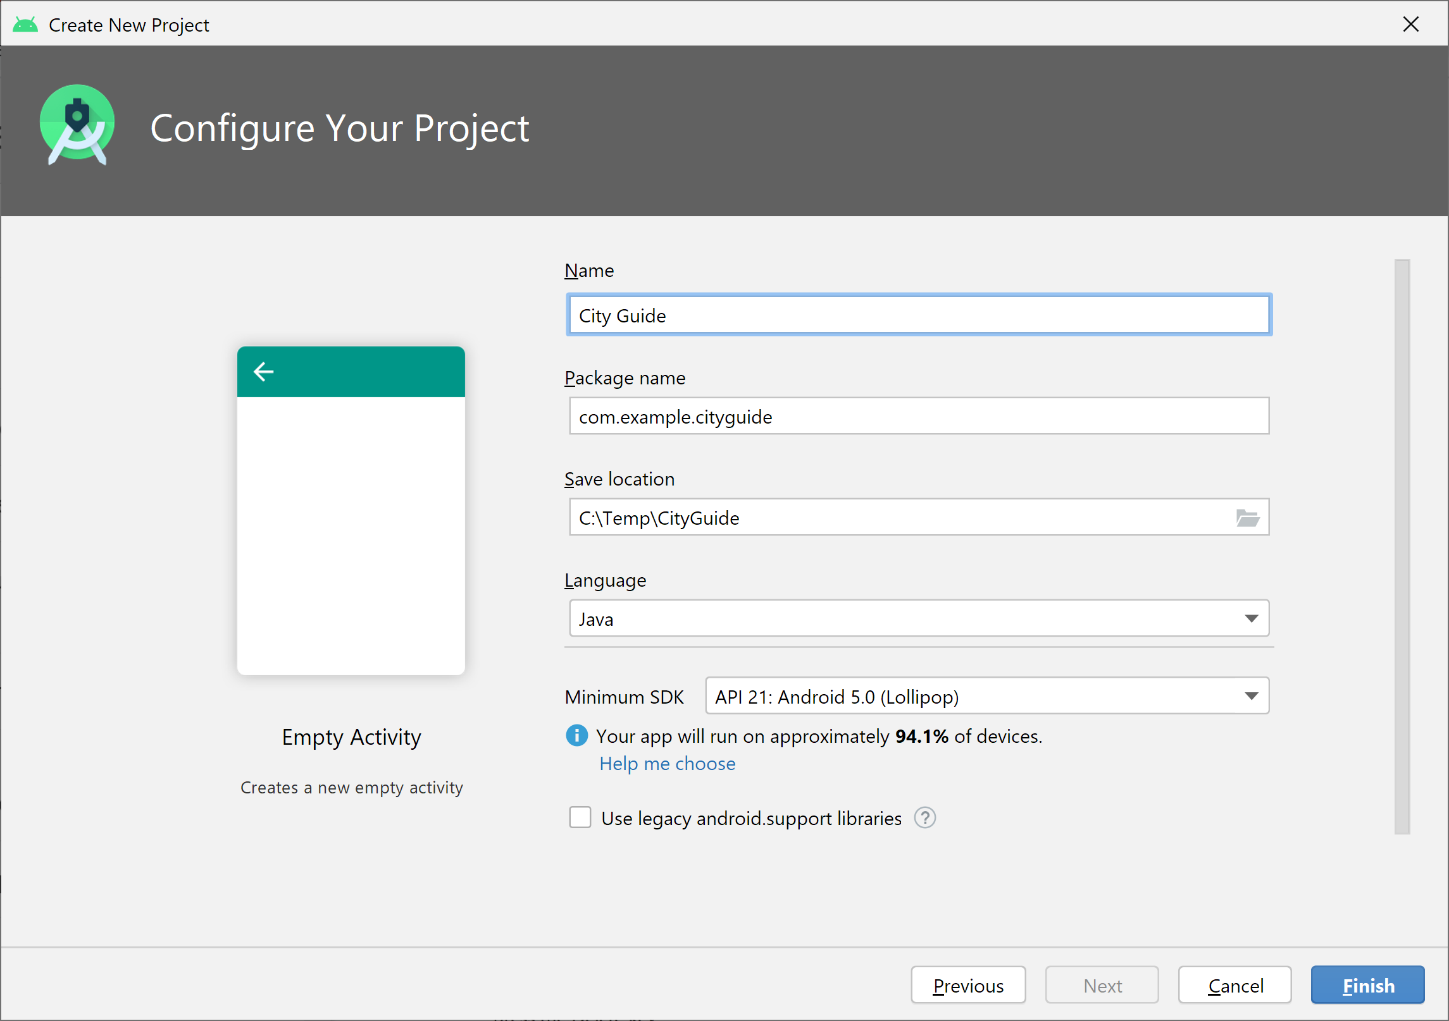
Extending a ListActivity
Create the project City Guide

Slide 11
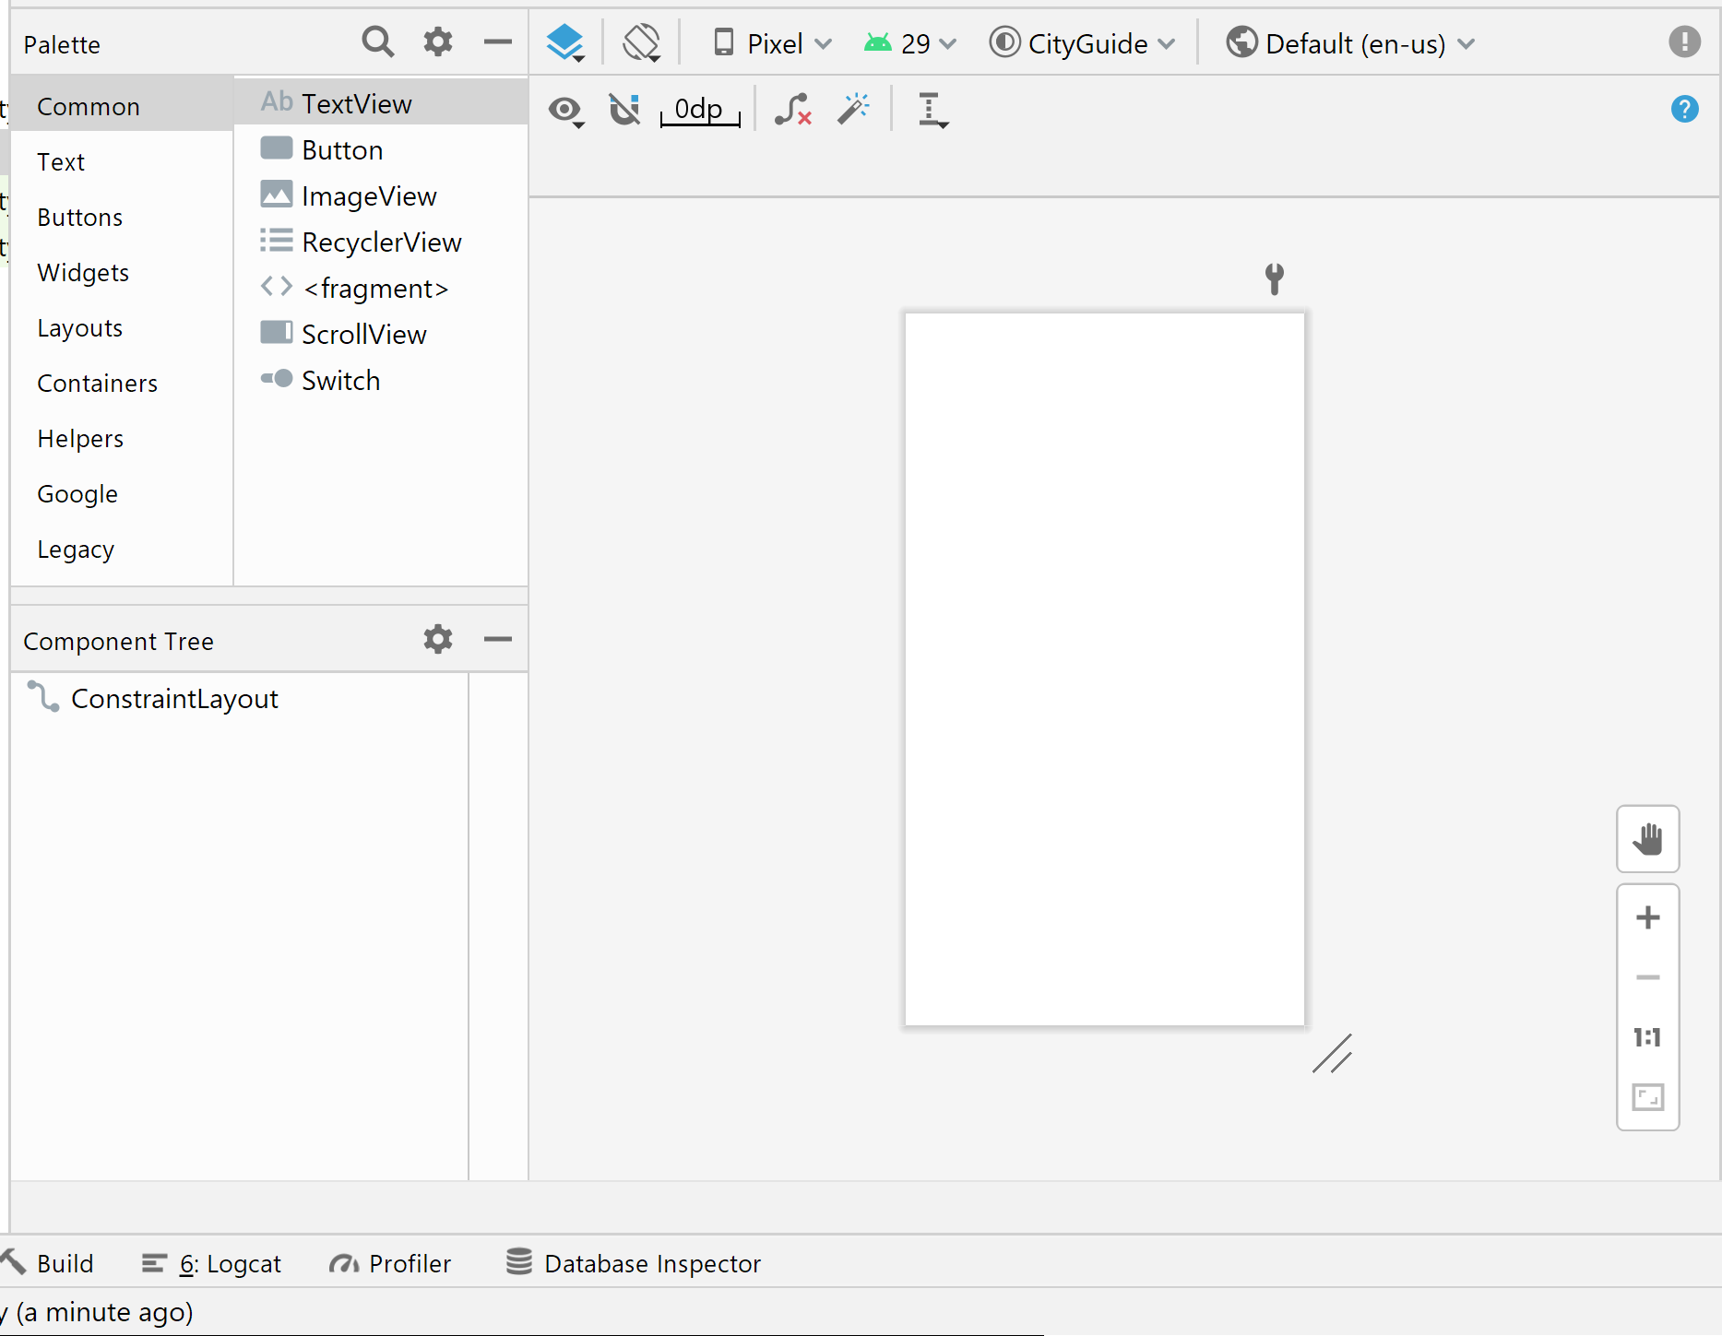
Extending a ListActivity
Delete “Hello World” TextView

Slide 12
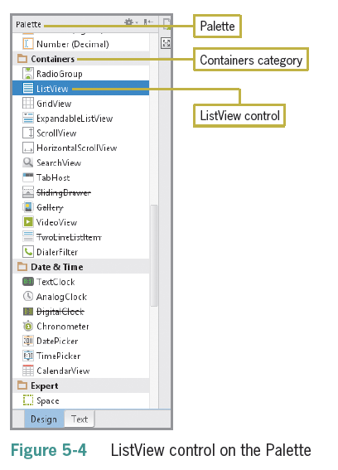
Extending a ListActivity
A ListActivity class is needed to display a list of items
An ExpandedlistView can be used to provide a two-level list

Slide 13
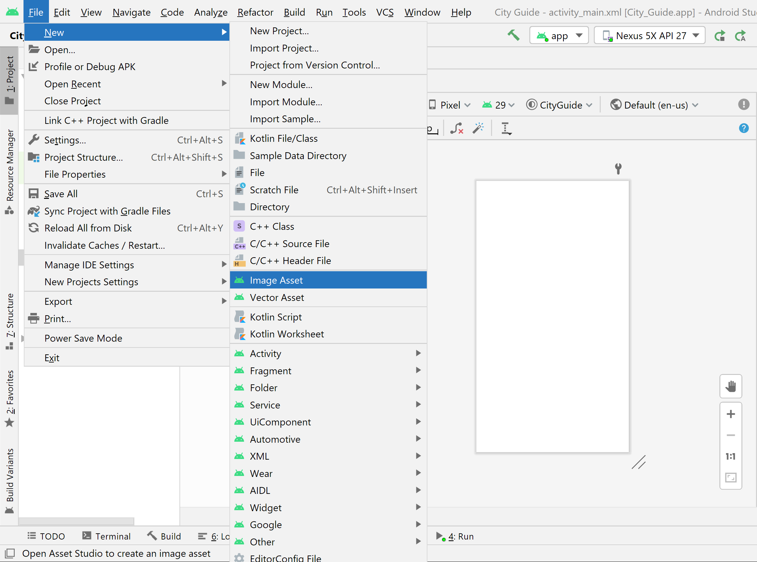
Extending a ListActivity
File → New → Image Asset

Slide 14
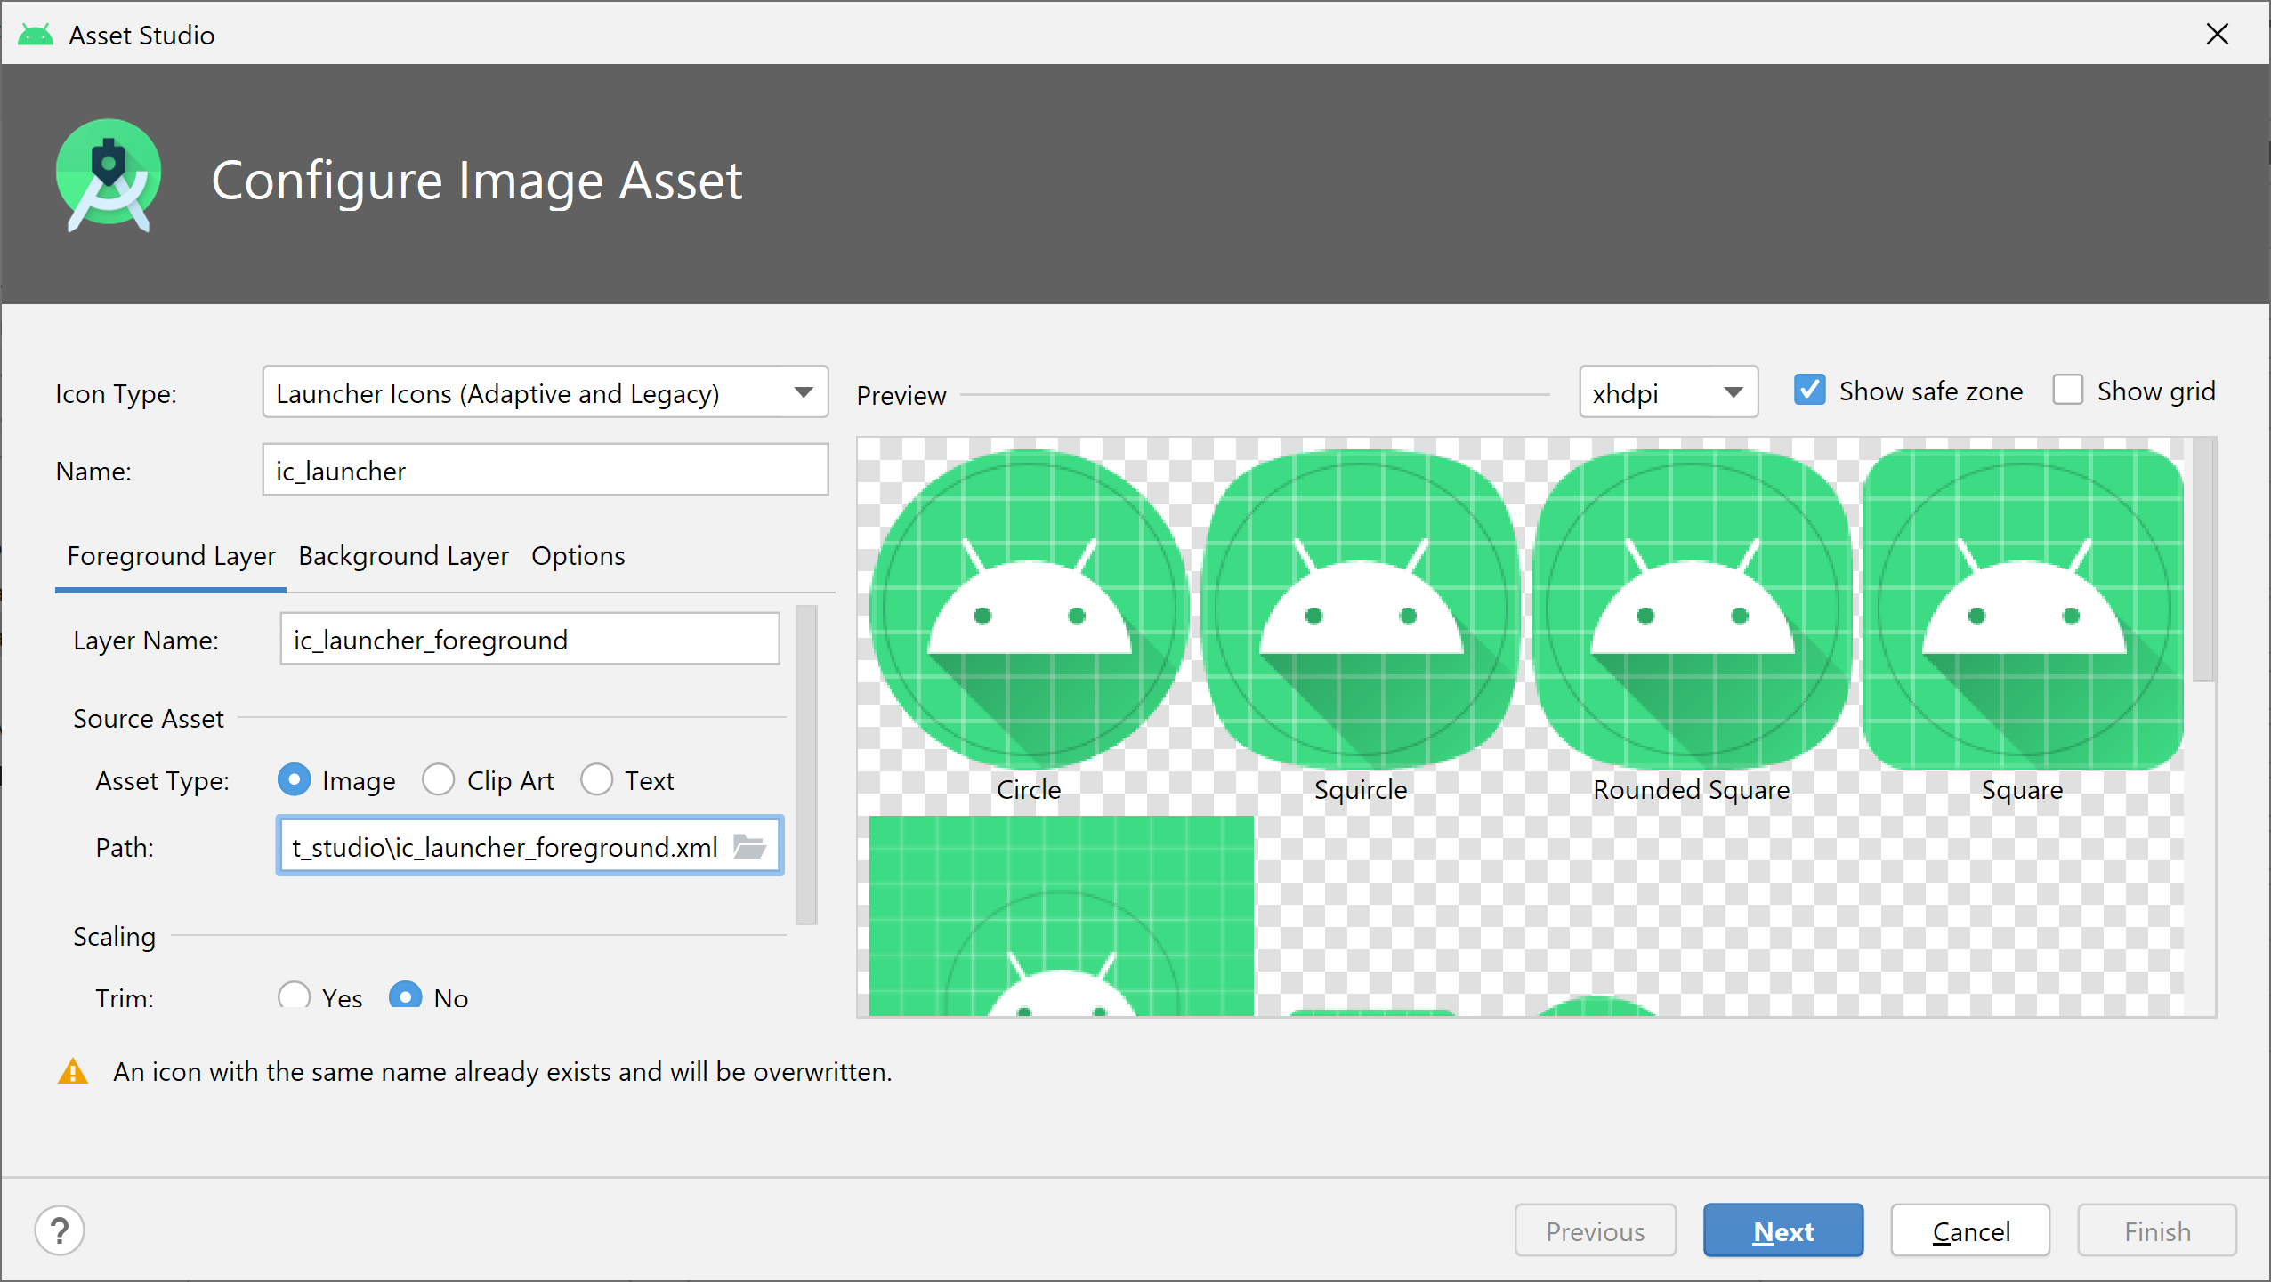
Extending a ListActivity
Change the launcher icon
Change the path

Slide 15
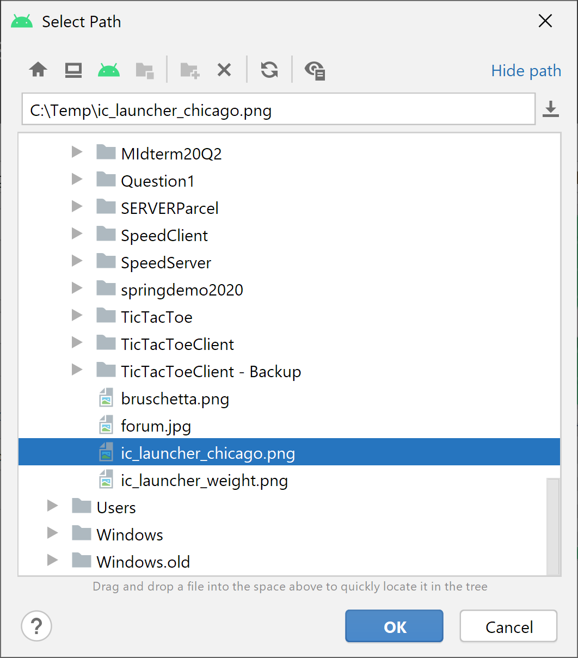
Extending a ListActivity
Change the launcher icon
Locate the file

Slide 16
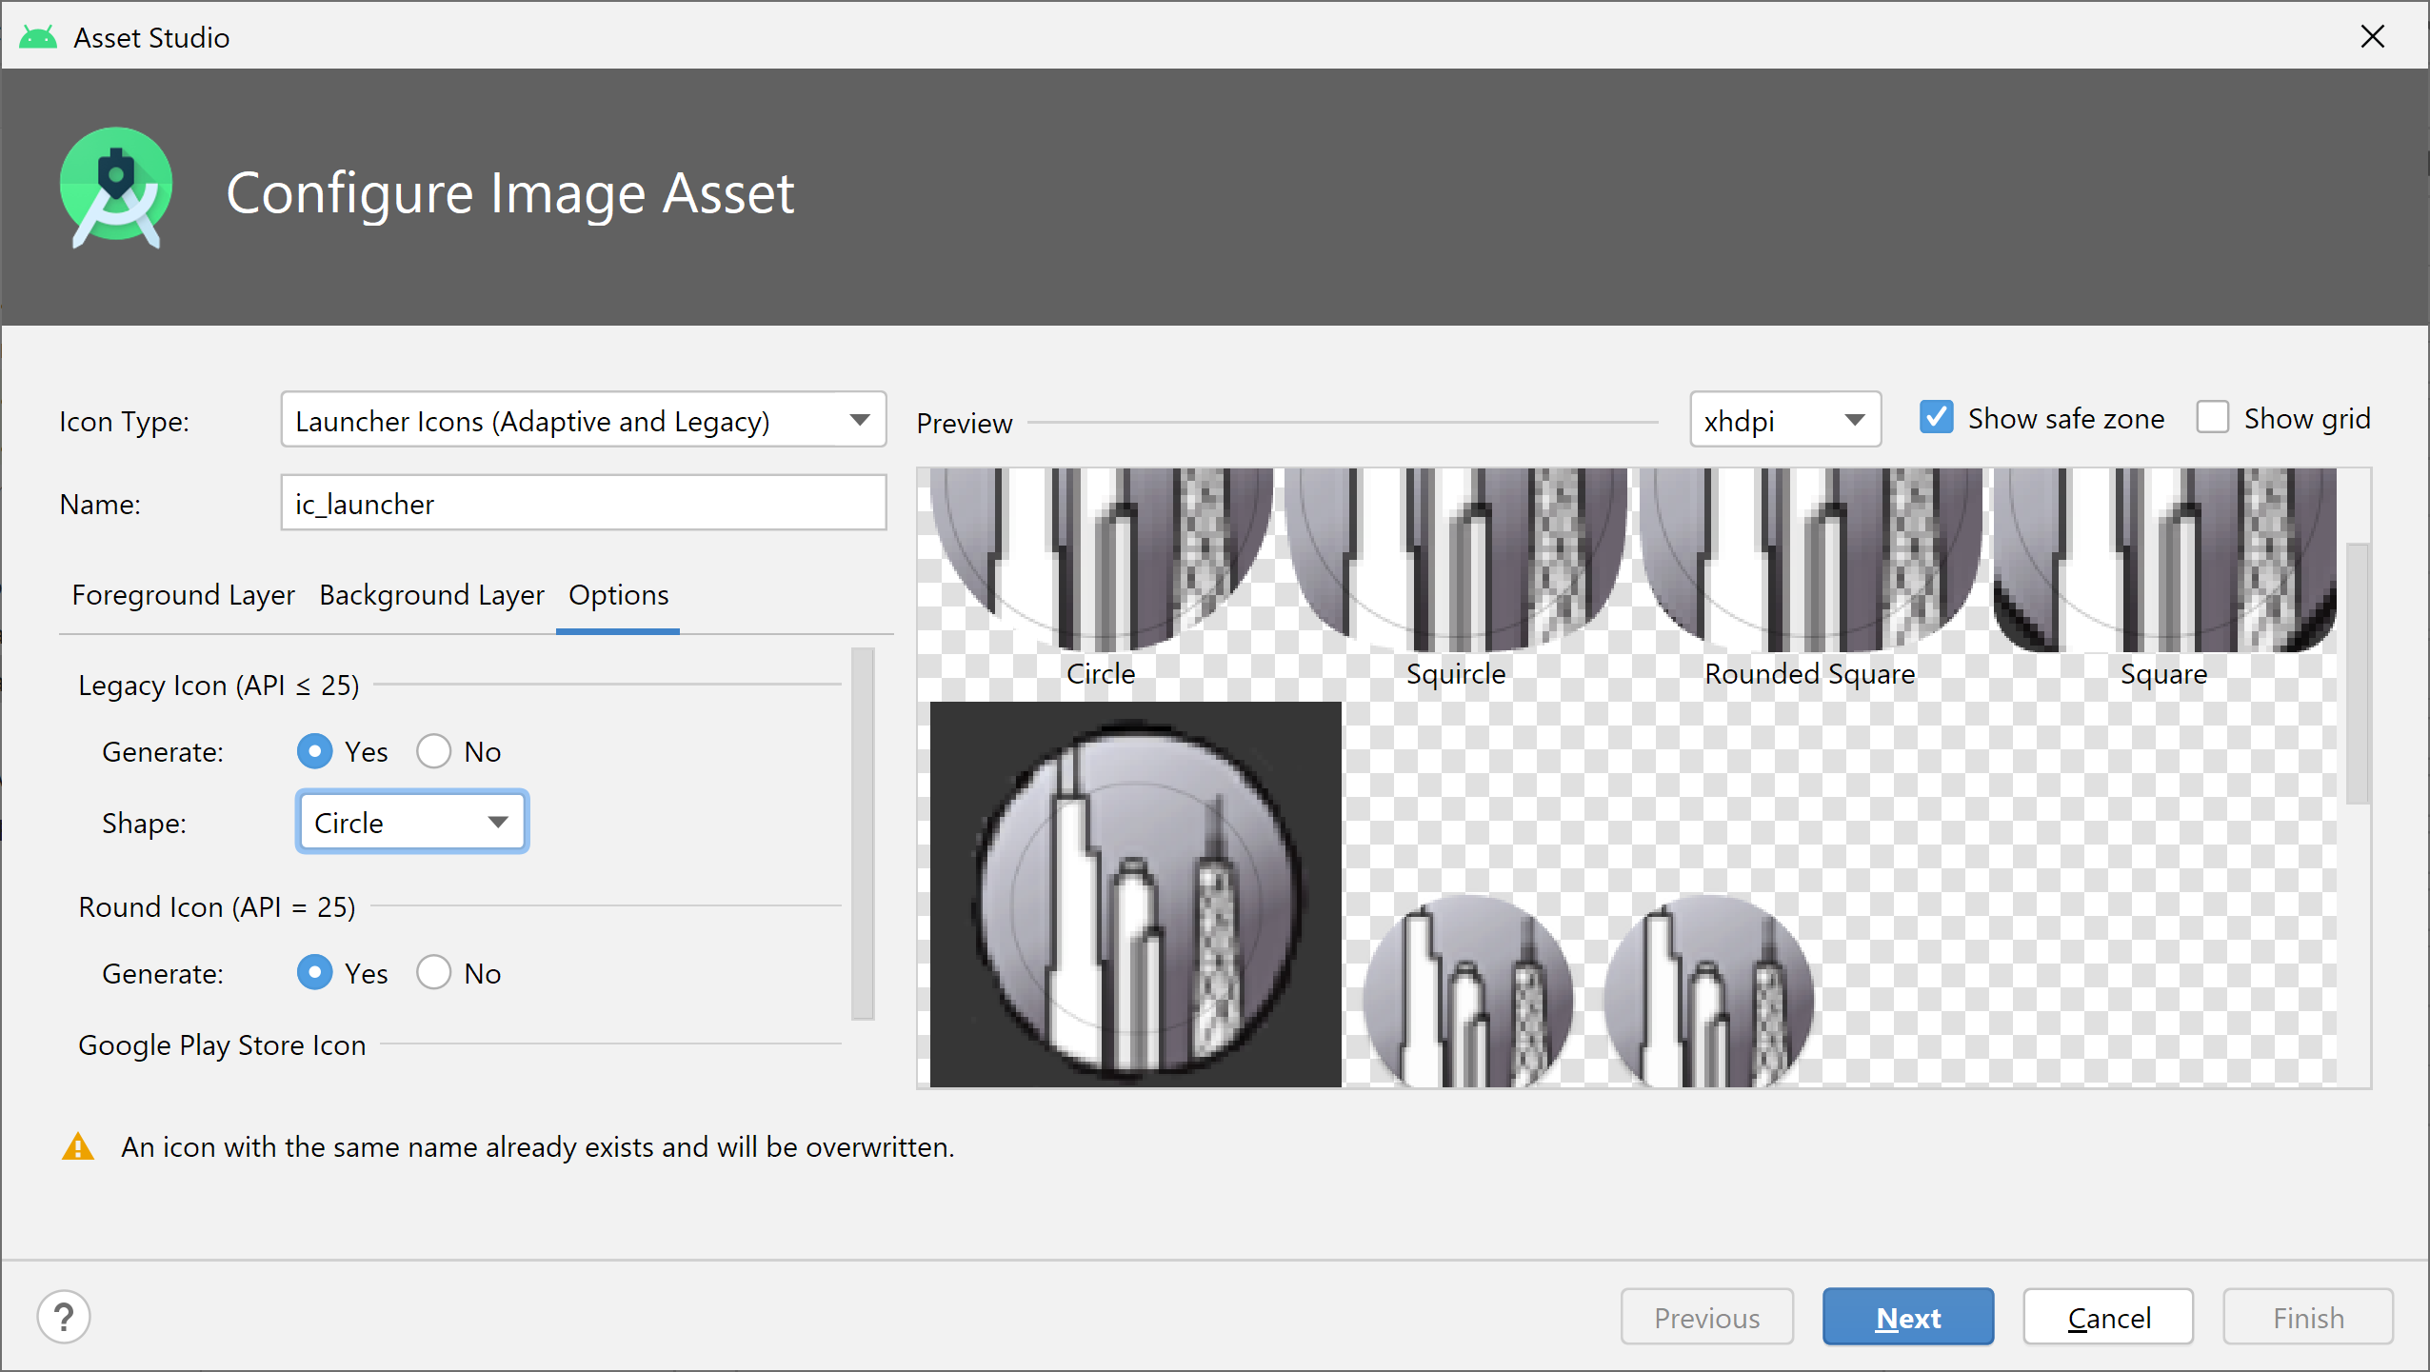
Extending a ListActivity
Change the launcher icon
Change to Circle

Slide 17
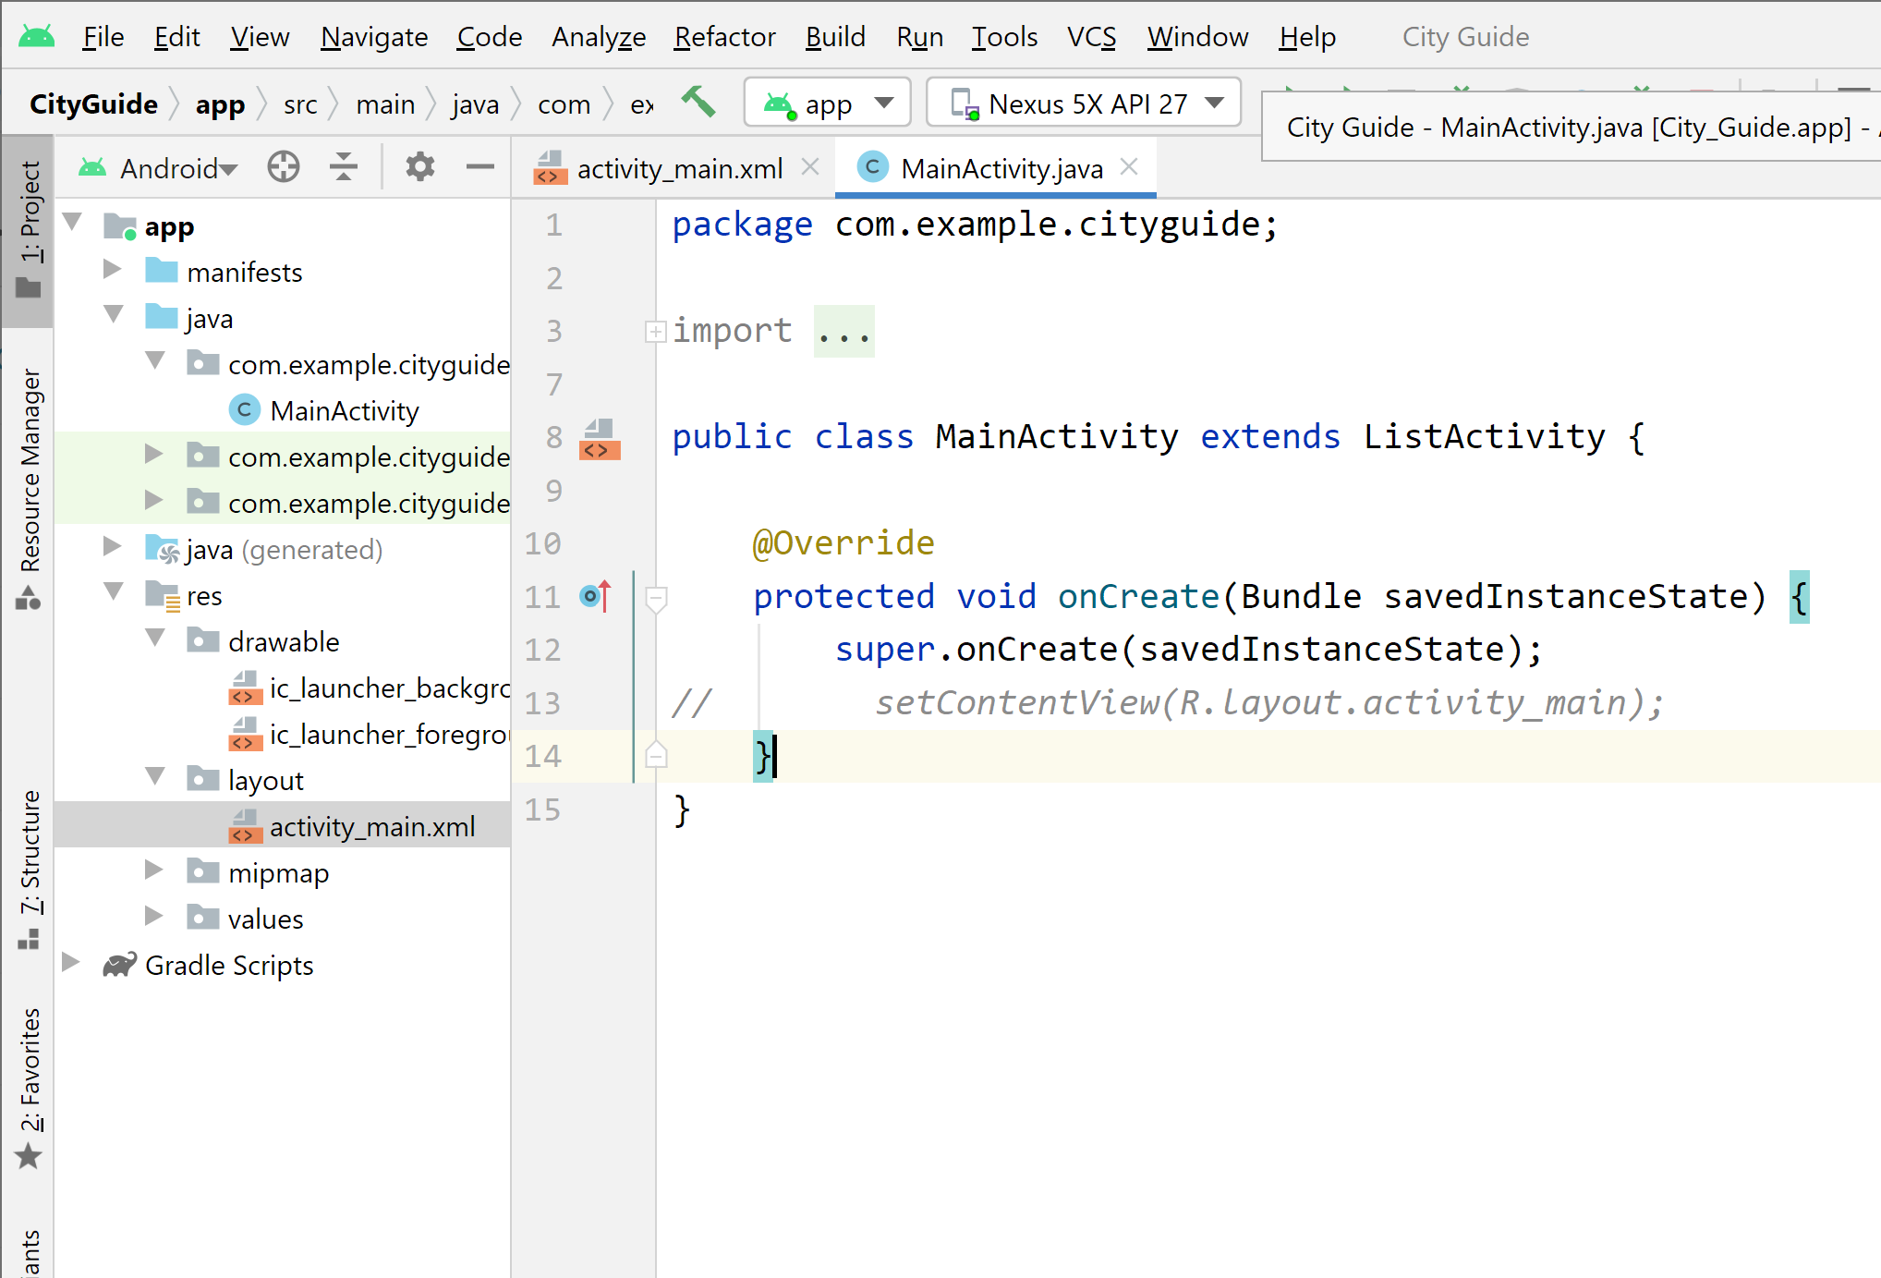
Extending a ListActivity
Extend ListActivity
Extend ListActivity
Delete or comment
Change to Circle

Slide 18
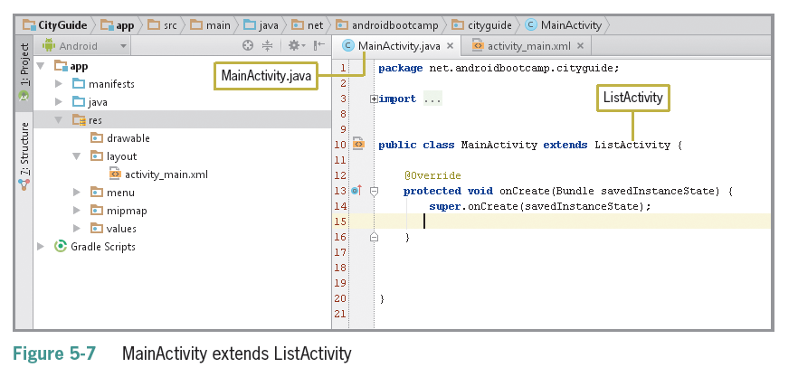
Extending a ListActivity (continued)

Slide 19
Creating an Array
Array variables can store more than one value
Different from other data types that can hold only one value
Each individual item in an array is called an element
Refer to each element using an index in the array

Slide 20
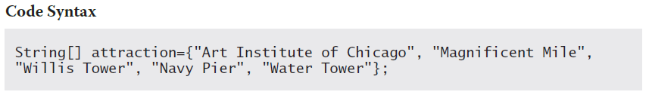
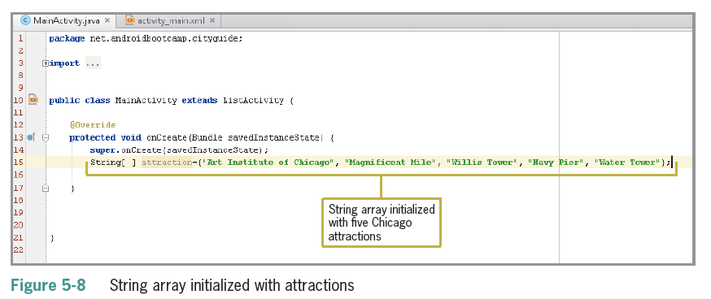
Declaring an Array
Square brackets [ ] are used to define an array
Curley braces { } contain the list of items in the array

Slide 21
Using a setListAdapter and Array Adapter
An adapter provides a model for the layout and converts the data into a list
The setListAdapter projects the data to the on-screen list by connecting the ListActivity’s ListView object to the array data
An array adapter supplies the array data to the ListView
setListAdapter(new ArrayAdapter<String>
(this,R.layout.support_simple_spinner_dropd own_item,attraction)
);

Slide 22
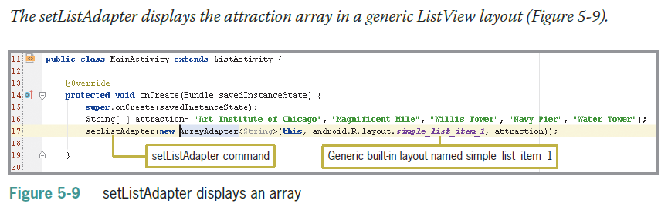
Using a setListAdapter and Array Adapter (continued)

Slide 23
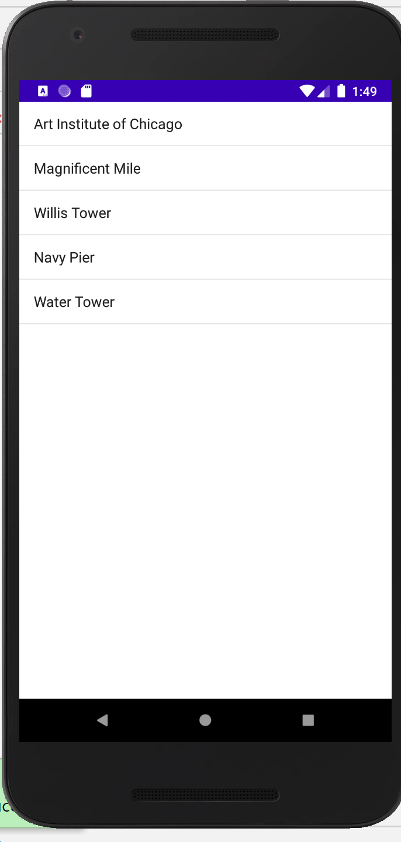
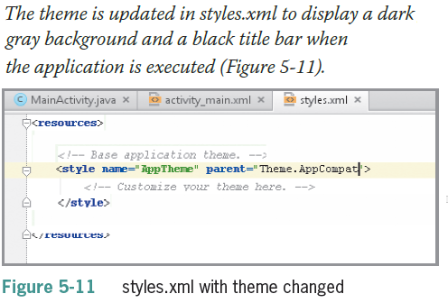
Using a setListAdapter and Array Adapter (continued)

Slide 24
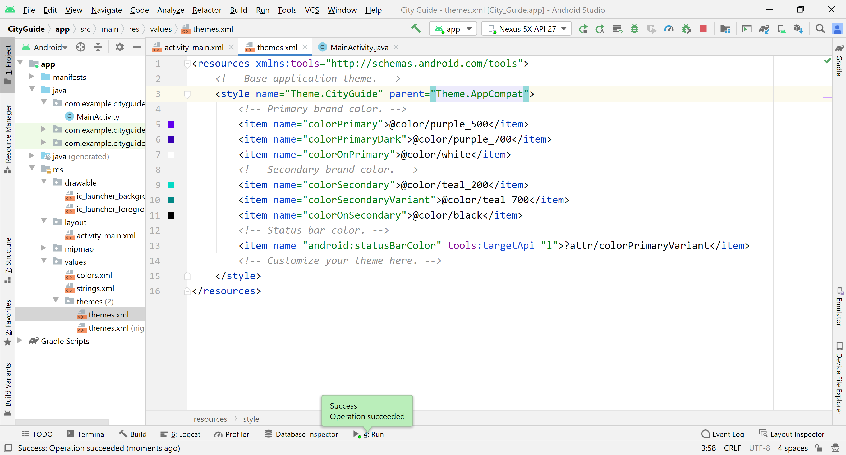
Using a setListAdapter and Array Adapter (continued)
Change to Theme.AppCompat

Slide 25
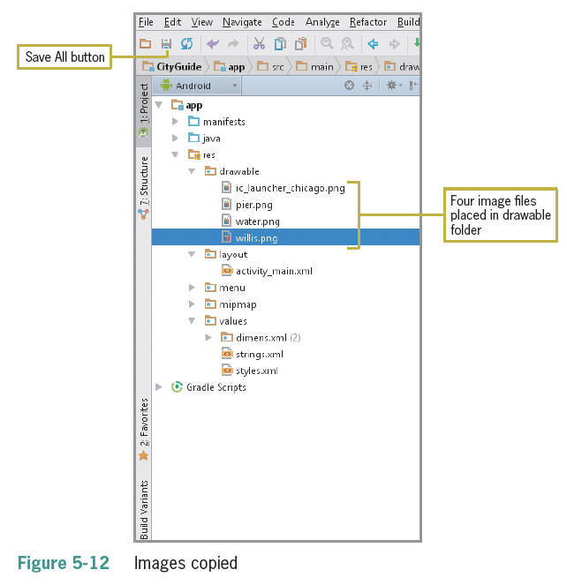
Adding the Images to the Resources Folder
Images must be located in the drawable-hdpi folder
Remember that images may be subject to copyright laws

Slide 26
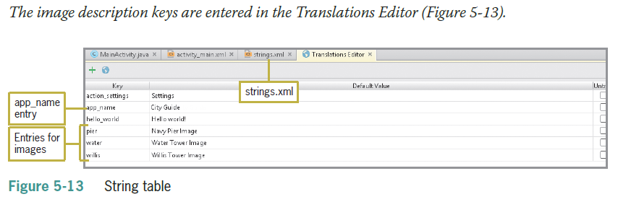
Adding the String Table

Slide 27
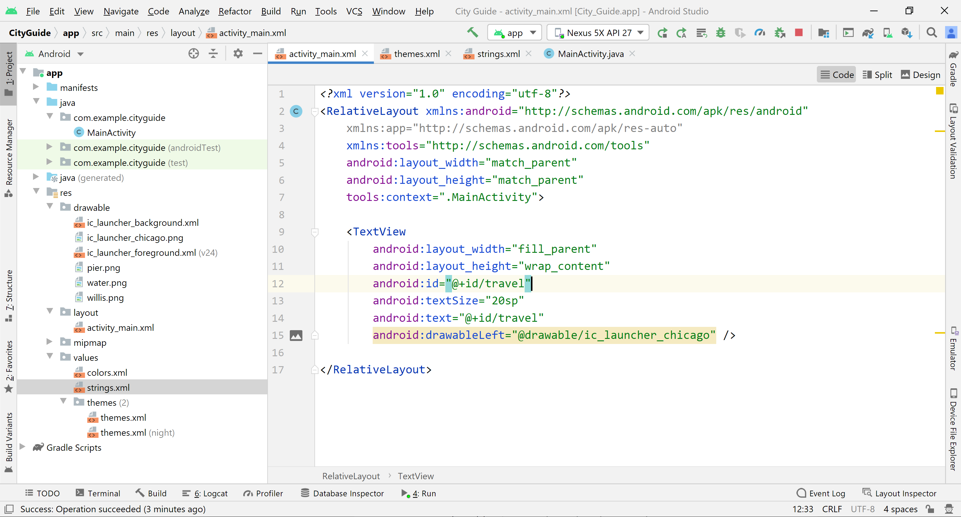
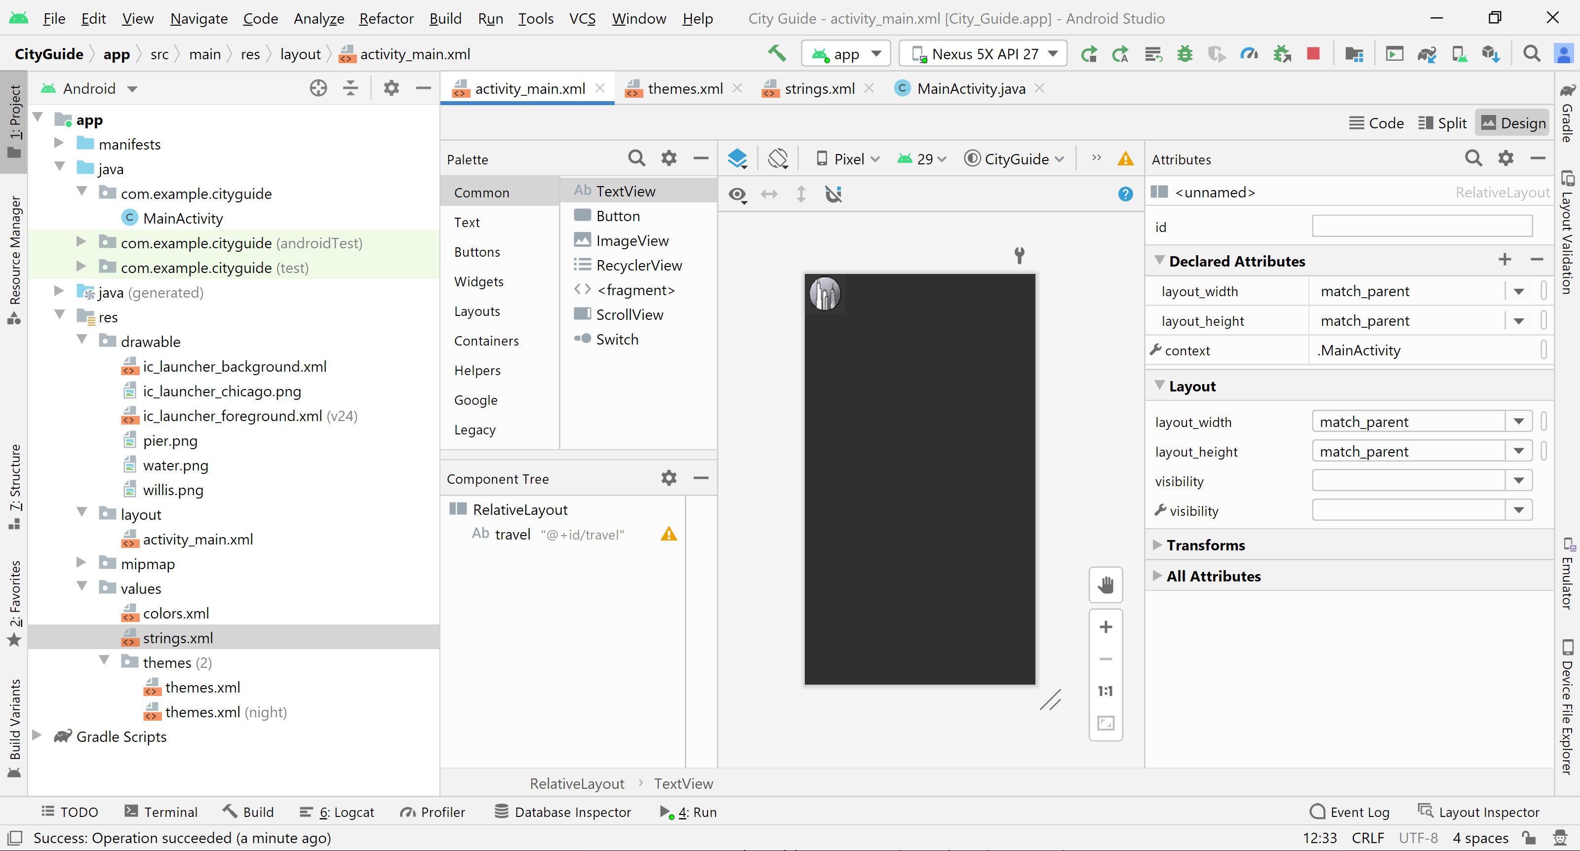
Creating a Custom XML Layout for a ListView

Slide 28
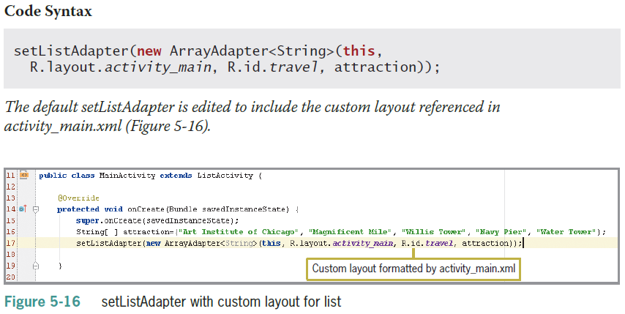
Coding a setListAdapter with a Custom XML Layout
Built-in layout is called simple_list_item_1

Slide 29
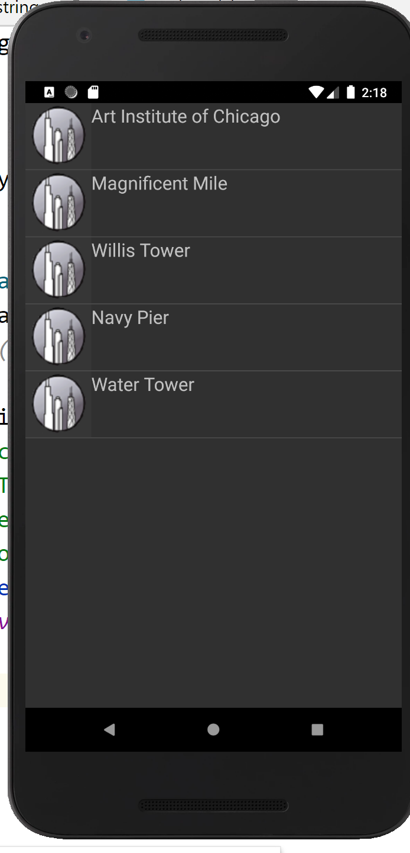
Coding a setListAdapter with a Custom XML Layout (continued)

Slide 30
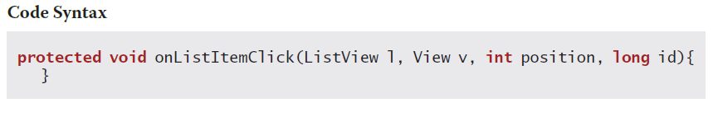
Using the onListItemClick method
onListItemClick() is called when an item from the list is selected
The item’s position in the list is captured so the app knows which of the items was selected
The position represents the number of the item in the list and id is row id of the item that was clicked

Slide 31
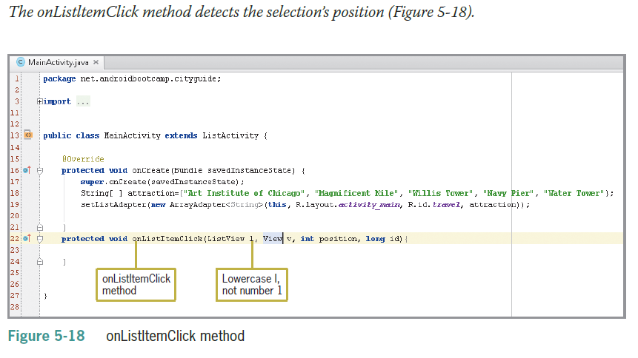
Using the onListItemClick method (continued)

Slide 32
Decision Structure – Switch Statement
If statements are also decision structures
The switch statement is used when there are many list items to be evaluated
Can only evaluate integers or single characters
The keyword case is used to test each item
The keyword break is used to exit the switch decision structure

Slide 33
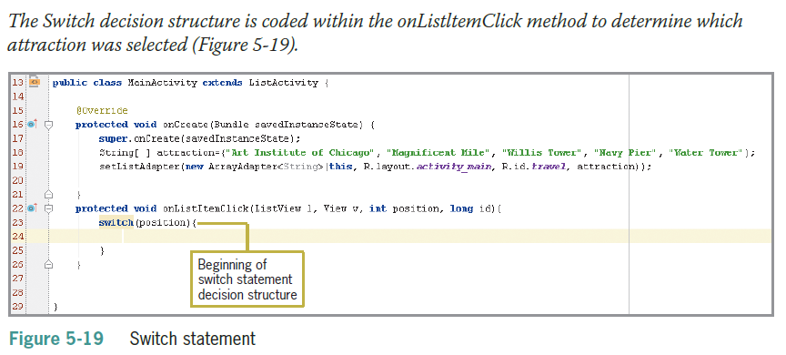
Decision Structure – Switch Statement (continued)

Slide 34
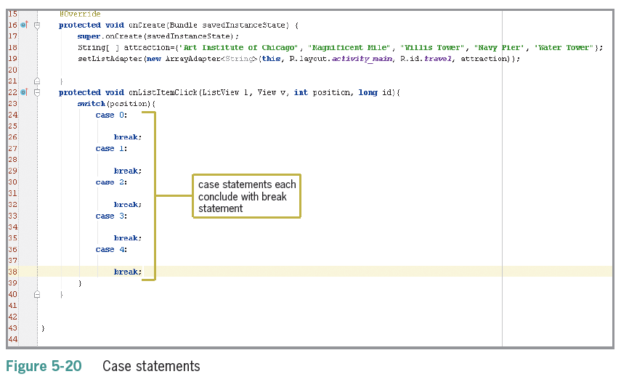
Decision Structure – Switch Statement (continued)

Slide 35
Android Intents
Android intents send and receive activities and services including:
Opening a Web page in a browser
Calling a phone number
Locating a GPS position on a map
Posting notes to a note-taking program
Opening your contacts list
Sending a photo
Posting to a social network

Slide 36
Launching the Browser from an Android Device
The intent sends the browser a URI (Uniform Resource Identifier)
URI is similar to URL (Uniform Resource Locator)
URI has additional information necessary for gaining access to the resources required for posting the page
The action called ACTION_VIEW (must be in caps) is what actually displays the page in the browser
ACTION_VIEW is the most common action performed on data

Slide 37
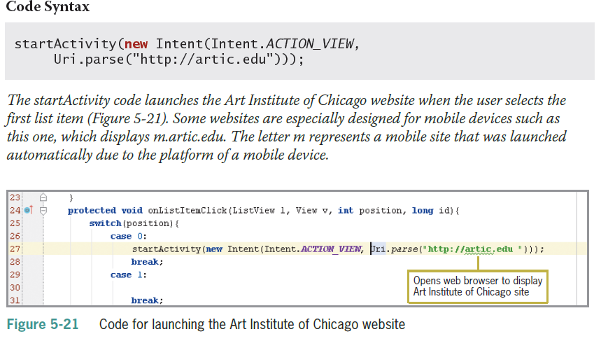
Launching the Browser from an Android Device (continued)

Slide 38
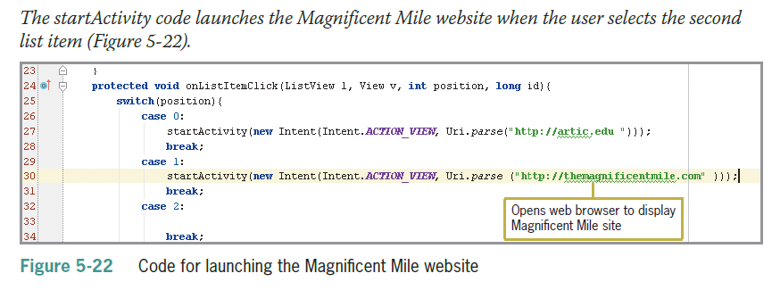
Launching the Browser from an Android Device (continued)

Slide 39
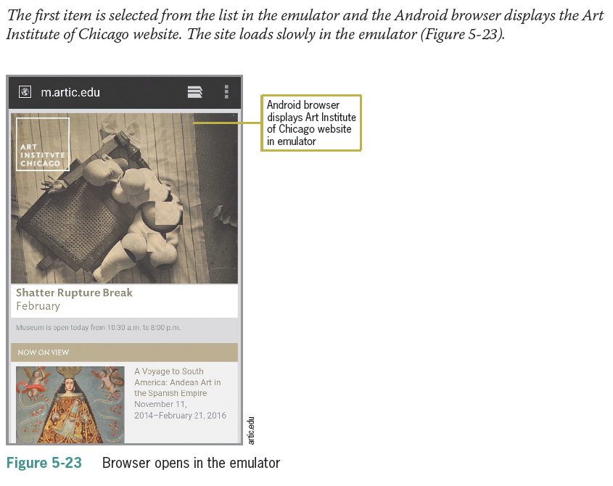
Launching the Browser from an Android Device (continued)

Slide 40
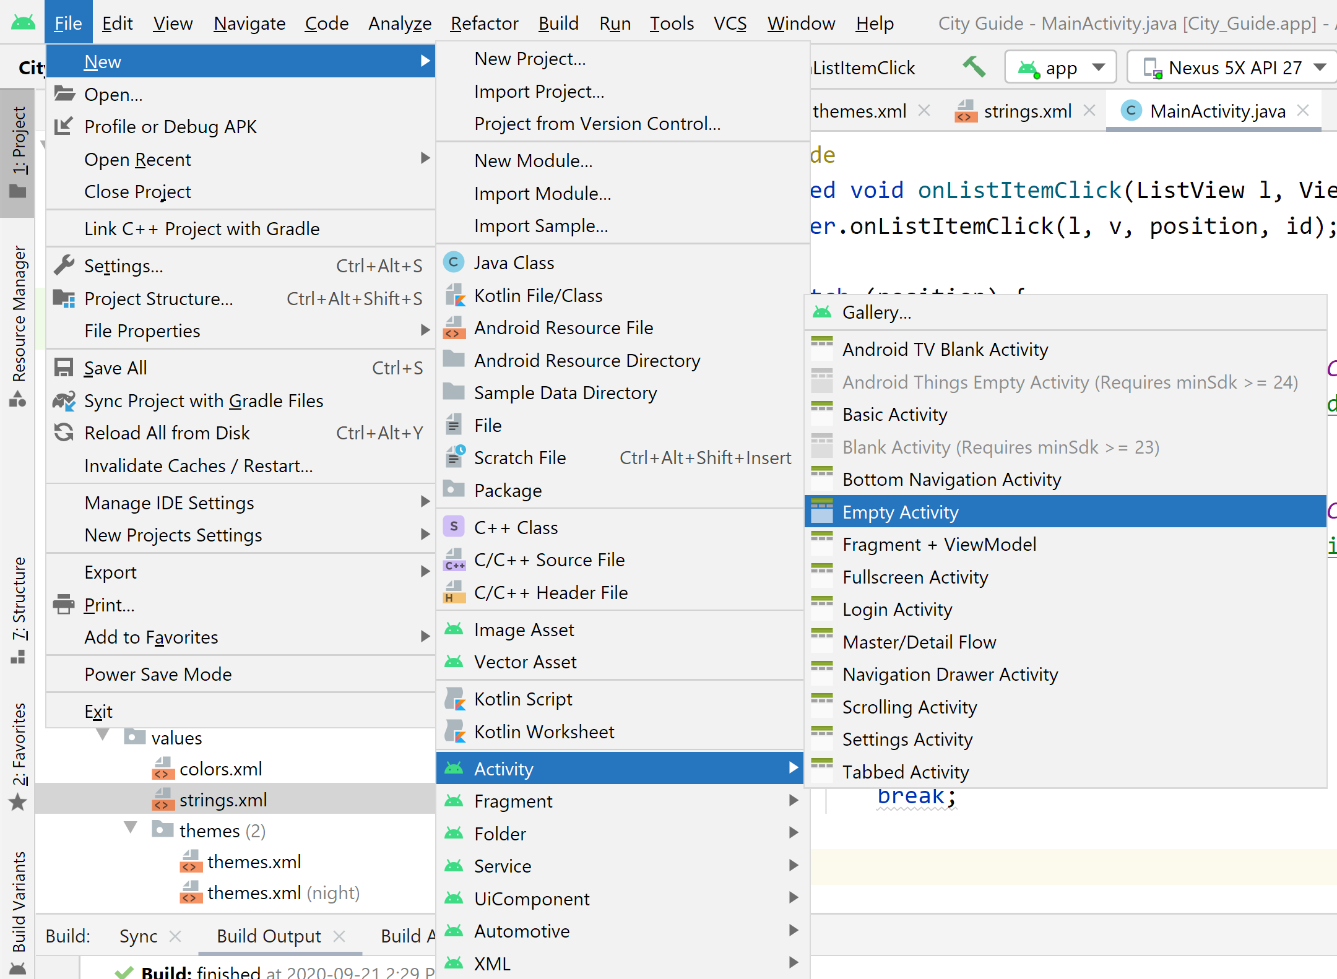
Adding Multiple Class Files
Class Files are needed to display images on the screen when the user selects options
An onCreate method requests that the user interface opens to display an image of the attraction

Slide 41
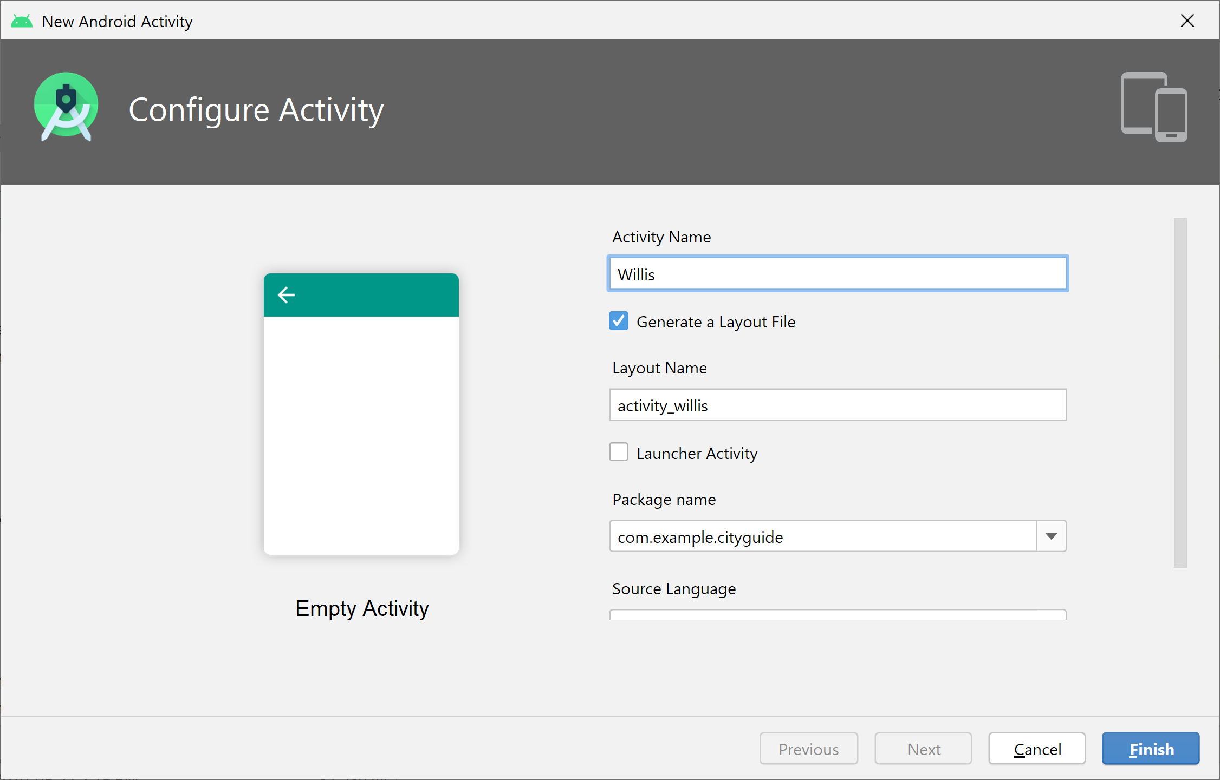
Adding Multiple Class Files
Class Files are needed to display images on the screen when the user selects options
An onCreate method requests that the user interface opens to display an image of the attraction

Slide 42
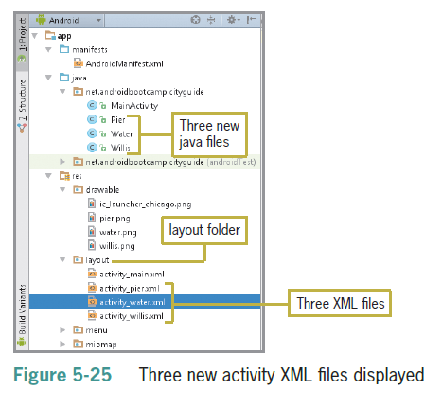
Adding Multiple Class Files (continued)

Slide 43
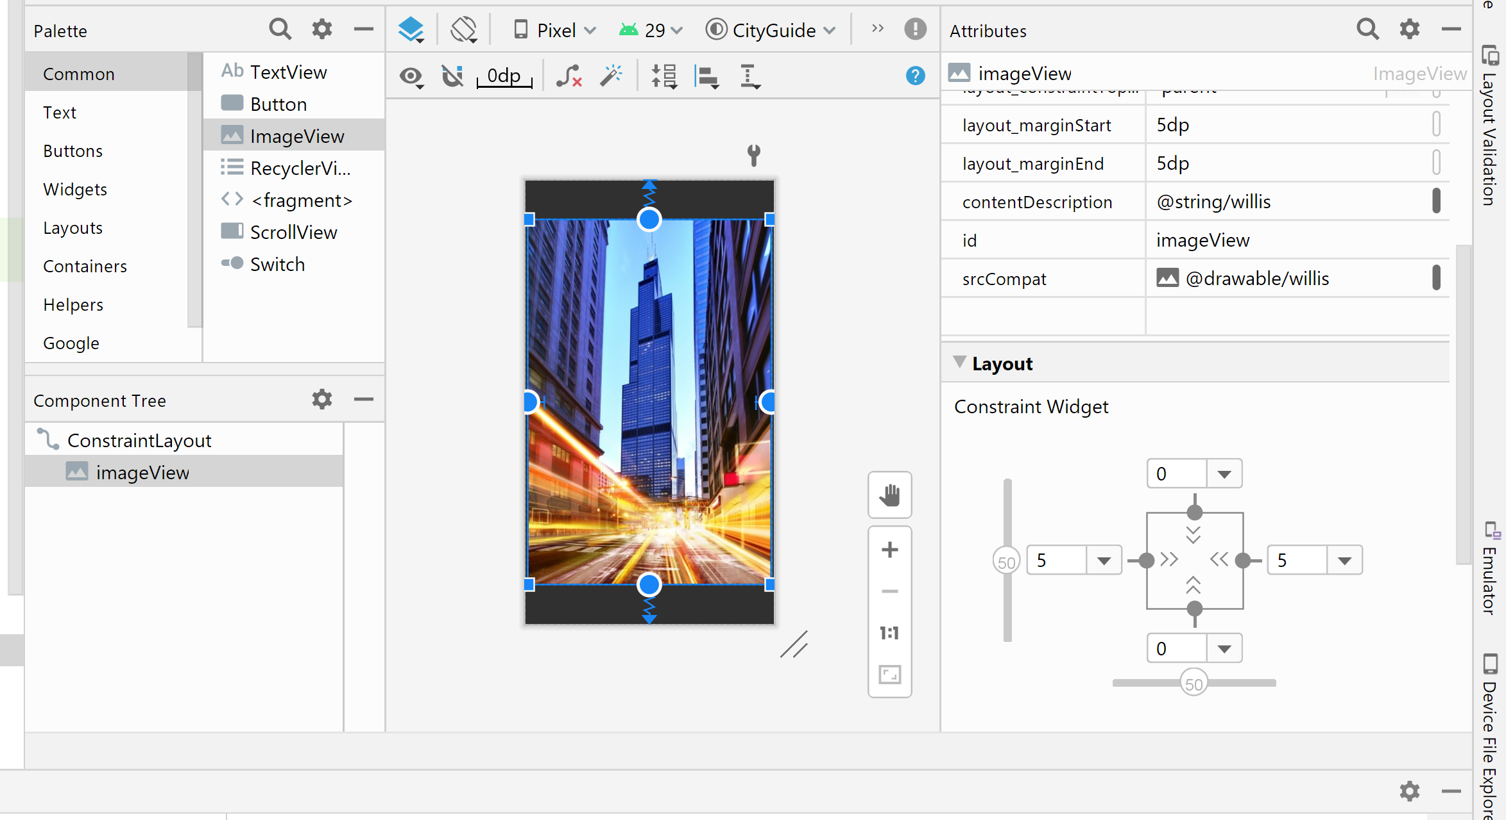
Designing XML Layout Files
contentDescription: @string/willis
srcCompat: @drawable/willis
Constiants

Slide 44
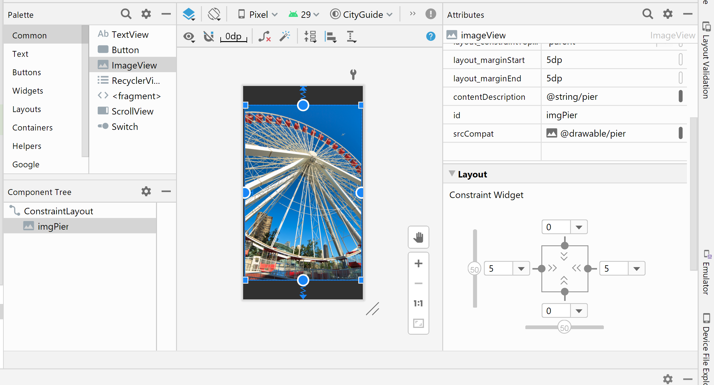
Designing XML Layout Files (continued)
contentDescription: @string/pier
srcCompat: @drawable/pier
Constiants

Slide 45
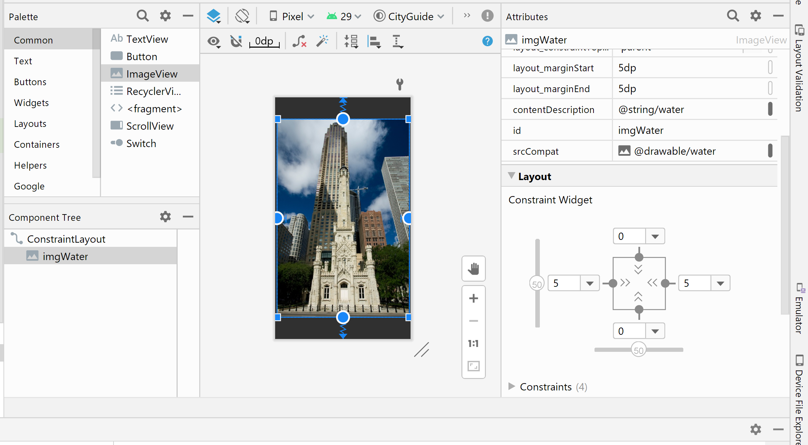
Designing XML Layout Files (continued)
contentDescription: @string/water
srcCompat: @drawable/water
Constiants

Slide 46
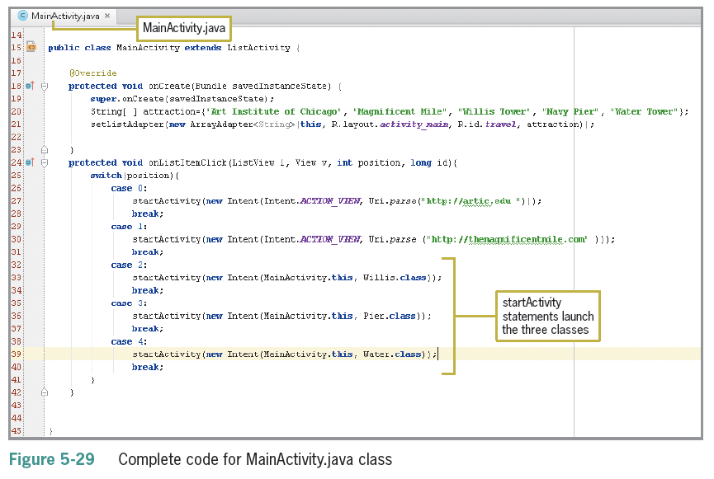
Opening the Class Files
A startActivity method opens the next Activity, which in turn launches the appropriate XML layout displaying an image of the attraction

Slide 47
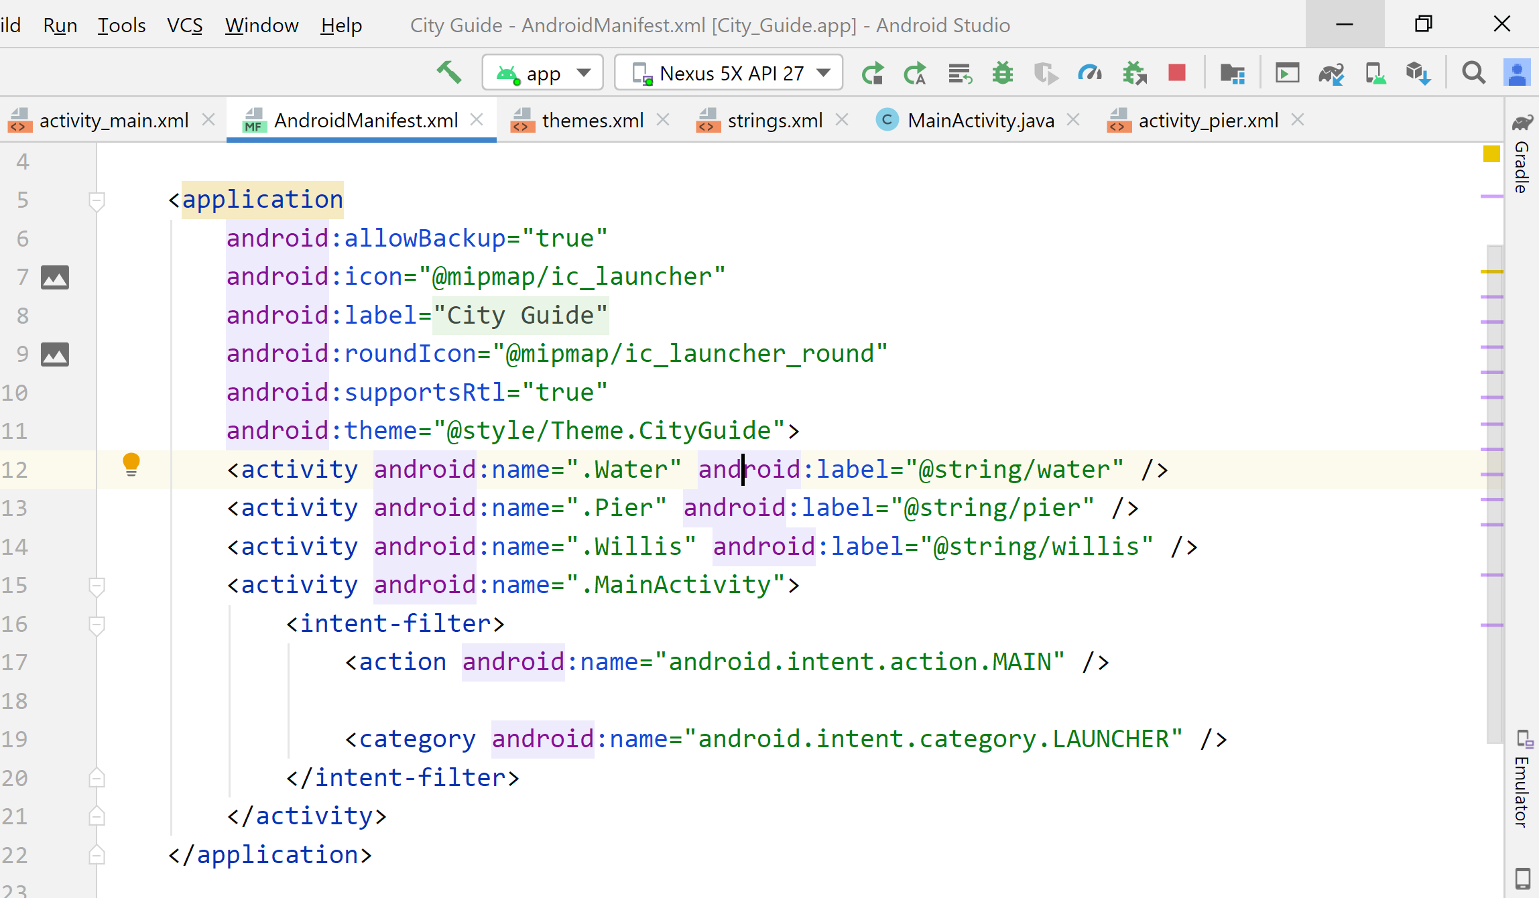
Changing the title
Add android:label in AndroidManifest.xml

Slide 48
Running and Testing the Application
Make sure all the fields can gracefully handle any tap or click or any value entered in any Android app
Testing an Android app is called usability testing
In addition to the traditional navigation and ease of use, Section 508 compliance is a third component to be tested
The 1998 Amendment to Section 508 of the Rehabilitation Act spells out accessibility requirements for individuals with certain disabilities
For more details, refer to www.section508.gov

Slide 49
Adding Images to the ListView
Create a new App
In activity_main.xml, add a ListView
Create a new layout file having Linear layout (horizontal) with one ImageView and one TextView
In java file add two arrays
String[] attraction={"Stanley Park","Capilano Bridge",
"Canada Place"};
int[] images ={R.drawable.canadaplace,R.drawable.capilano,R.drawable.canadaplace};

Slide 50
Adding Images to the ListView
In java file add following code:
List<HashMap<String,String>> aList = new ArrayList<HashMap<String,String>>();
for(int i=0;i<3;i++){
HashMap<String, String> hm = new HashMap<String,String>();
hm.put("txt","Place :" + attraction[i]);
hm.put("images", Integer.toString(images[i]) );
aList.add(hm);
}
String[] from = { "images","txt"}; // Keys used in Hashmap
int[] to = { R.id.image,R.id.text}; // Ids of views in listview_layout

Slide 51
Adding Images to the ListView
// Instantiating an adapter to store each items
// R.layout.listview_layout defines the layout of each item
SimpleAdapter adapter = new SimpleAdapter(getBaseContext(), aList, R.layout.listview_layout, from, to);
// Getting a reference to listview of activity_main.xml layout file
ListView listView = ( ListView ) findViewById(R.id.listView);
// Setting the adapter to the listView
listView.setAdapter(adapter);

Slide 52
Adding Images to the ListView
listView.setOnItemClickListener(new AdapterView.OnItemClickListener() {
@Override
public void onItemClick(AdapterView<?> parent, View view, int position, long id) {
switch (position){
case 0:
break;
case 1:
break;
}
}
});

Slide 53
Summary
The Java View class creates a list and makes it scrollable; use a ListView control to select each row for further action
Extend the ListActivity class in Main.java to display a ListView control
Declare list items in an array variable
Array indexes provide access to each element in the list (the list begins with 0)
To declare an array, specify the data type followed by the values

Slide 54
Summary (continued)
Use an adapter to display the values in the array
A ListView control is a container for the list items and the adapter binds the elements of the array to the ListView layout statements if the condition is false
Drag controls from the palette to the emulator for a simple design
Add code to the main.xml file to get a custom layout

Slide 55
Summary (continued)
App names are displayed in the app title bar – can be customized
setListAdapter has 3 parameters:
this class
The layout used to display the list
The array containing the list values
Code the onListItemClick method to respond to the event of the user’s selection
Use the switch decision structure with a list or menu

Slide 56
Summary (continued)
Android intents send and receive activities and services
Test every possible combination of clicks, including incorrect user entries before publishing the app

